Slide 1


Reinforcement Learning-Based AI Player for Tic-Tac-Toe Game
Team Members:
Niraj Jaishwal
Ardacan Yildiz
Nuwan Janaranga

Slide 2
Outline
High-level Objective
Basics on Reinforcement Learning
Our Setup
Results

Slide 3
Abstract
Objective: Build a reinforcement learning (Q-learning) agent to play Tic-Tac-Toe
Key Features:
Learns through self-play
No hardcoded rules
Evaluated against Random and Minimax players
Goal: Demonstrate RL fundamental in a simple environment

Slide 4
Introduction
Machine learning has transformed game-playing AI, enabling the development of intelligent agents that achieve and often surpass human-level performance.
Notable early achievement was IBM's Deep Blue, which defeated the reigning world chess champion Garry Kasparov in 1997.
DeepMind's AlphaGo demonstrated this by defeating a world champion Go player in 2016.

Slide 5
Reinforcement Learning
Reinforcement learning (RL) has been pivotal in advancing game-playing AI.
Deep Q-Networks (DQN), introduced by DeepMind, were a significant leap forward, enabling AI agents to learn successful policies directly from raw pixel inputs in Atari games.
This approach highlighted the potential of RL to handle complex decision-making processes without requiring handcrafted features

Slide 6
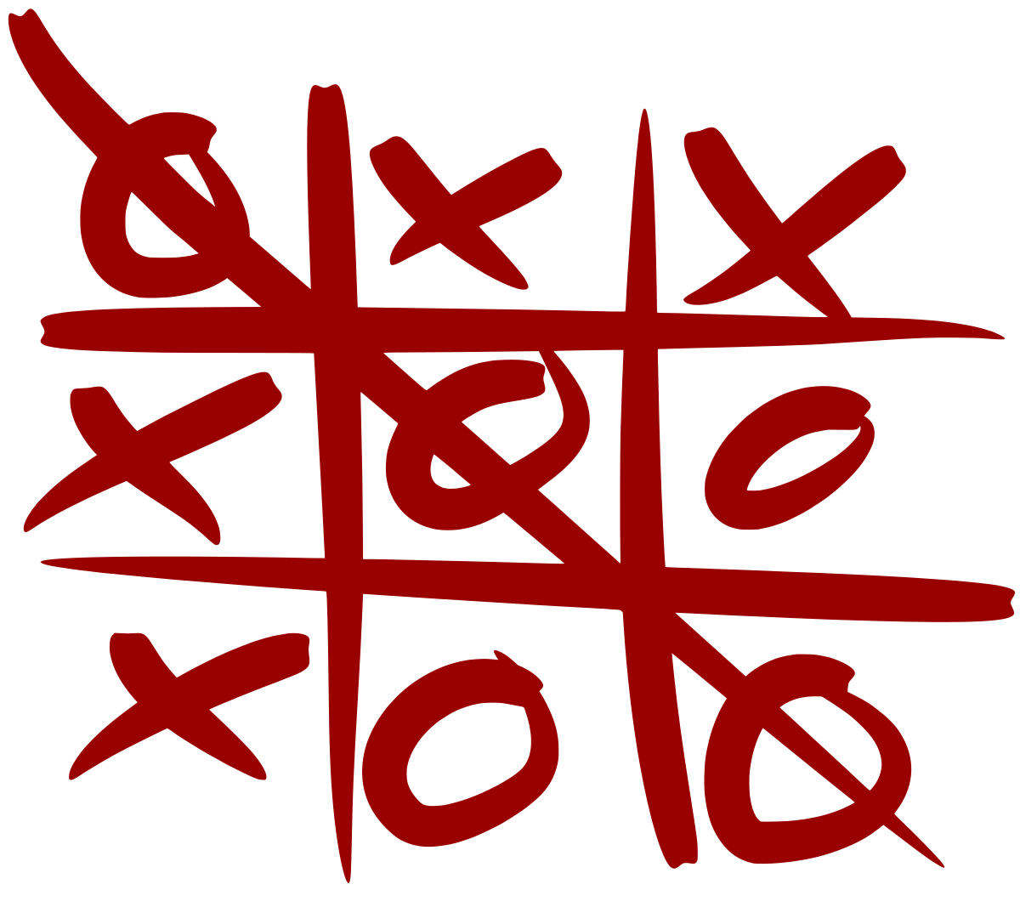
Tic-Tac-Toe Game
Why Tic-Tac-Toe
Simple state space
Ideal to understand decision making, adversarial strategy and optimal policy
Why Q-Learning:
Dataset-free, iterative improvement
Great intro to RL concepts in dynamic settings

Slide 7
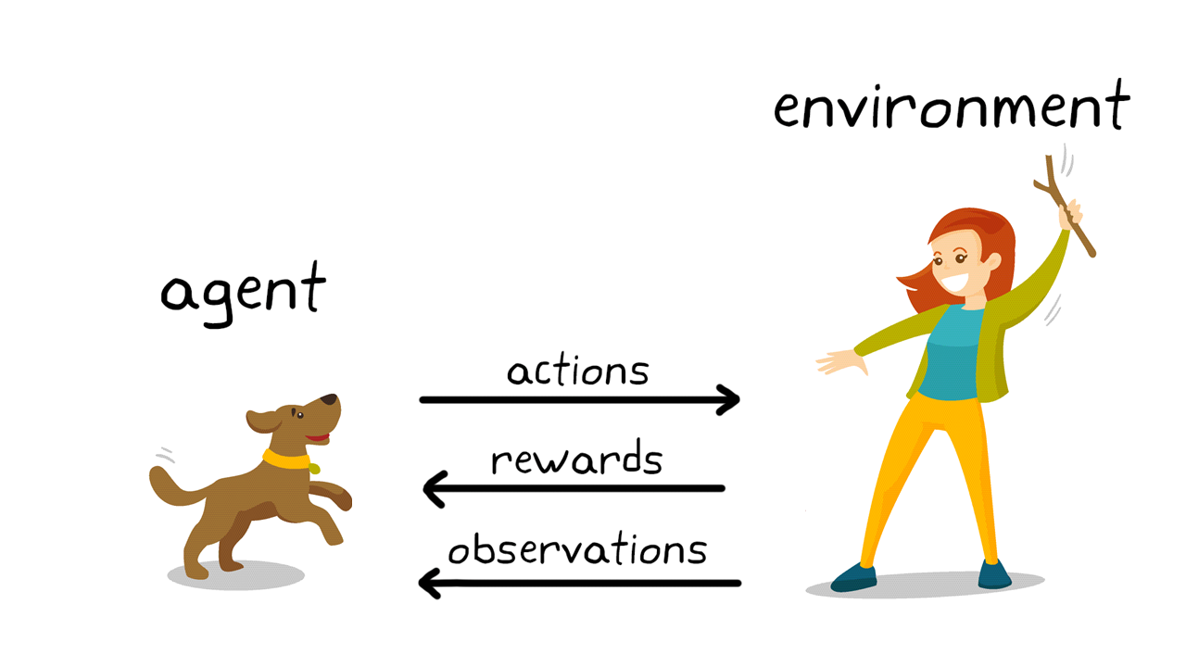

RL – Core Concepts
Fundamental Components: agents, environments, states, actions, rewards, and policies
Goal: Maximize cumulative reward

Slide 8
Setup for Tic-Tac-Toe
State Space (S): The state space S consists of all possible board configurations.
Action Space (A): The action space A includes all possible moves in the game.
Reward Function (R): The reward function provides feedback based on the outcome of the game. Win = +1, Loss = -1, Draw or no win/loss yet = 0
Q-Value Function (Q(s, a)): The Q-value function estimates the expected return.

Slide 9
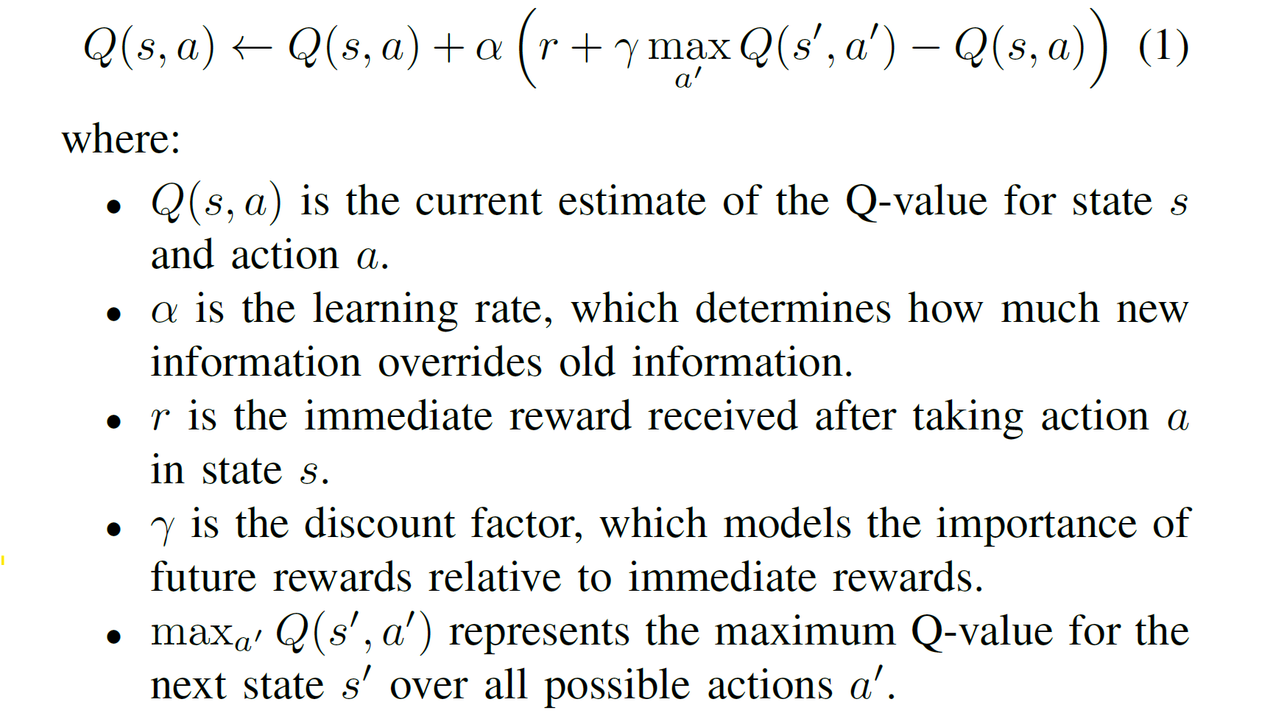
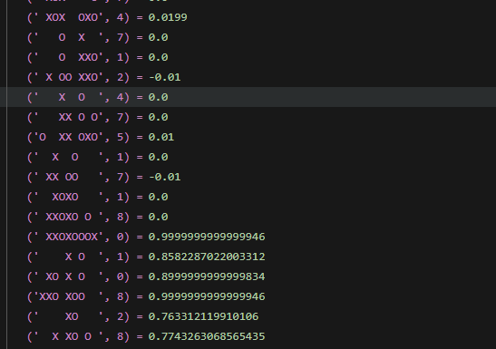

Q-Learning Algorithm
The core idea of Q-learning is to iteratively update the Q-values based on the agent’s experiences
$$\left(s,a\right)=Q$$

Slide 10
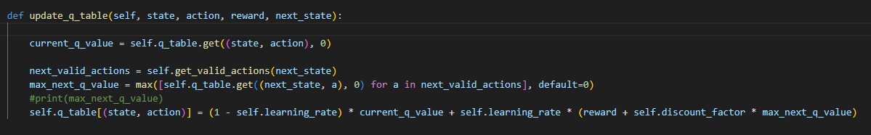




Update Q-Table
The agent uses a simplified representation where each state-action pair has one entry in the Q-table.
$s$ – Current State
$a$ – Agent Action
$s^{′}$ – Next State
 |  | X
 | O
X |  | X
 | O
X |  | X
 | O
O
$$\left(s,a\right)=Q$$

Slide 11
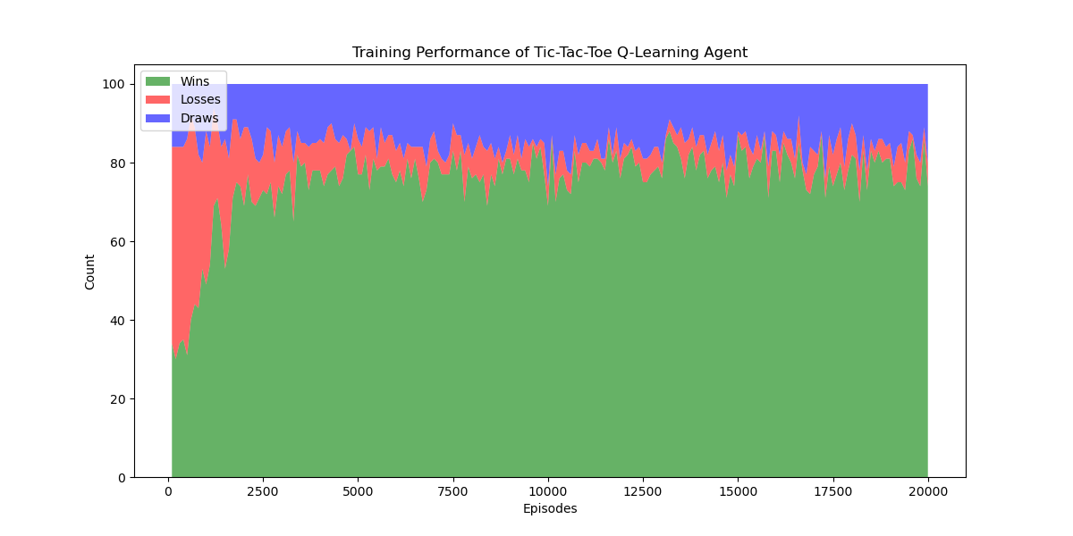
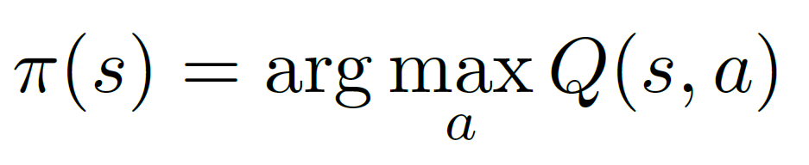
Training
The optimal parameters were found to be:
Learning Rate (α): 0.1
Discount Factor (γ): 0.9
Exploration Rate (ϵ): 0.1
Exploration Decay: 0.9
The agent undergoes training by playing a series of games against an opponent, which in this case, is a random player.
Once the Q-values have sufficiently converged, the agent’s optimal policy is extracted.

Slide 12
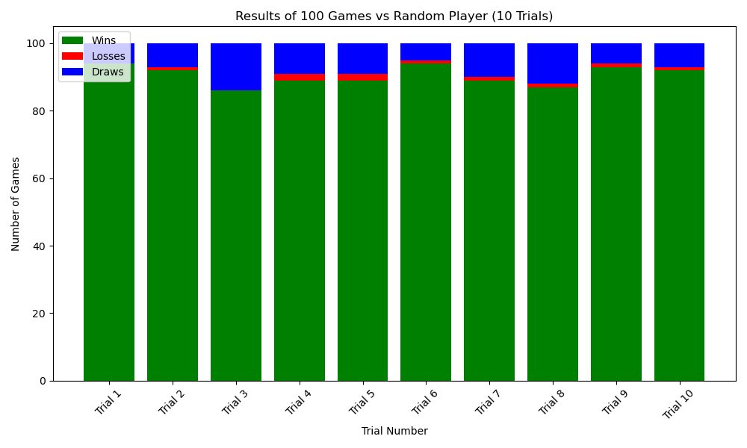
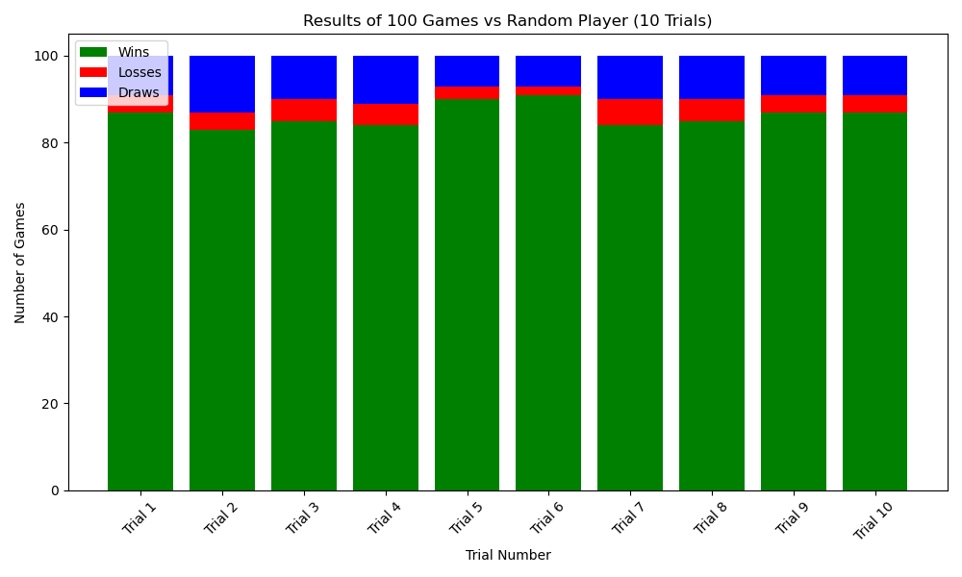
Performance Evaluation
Agent plays the game first
Agent plays the game second

Slide 13
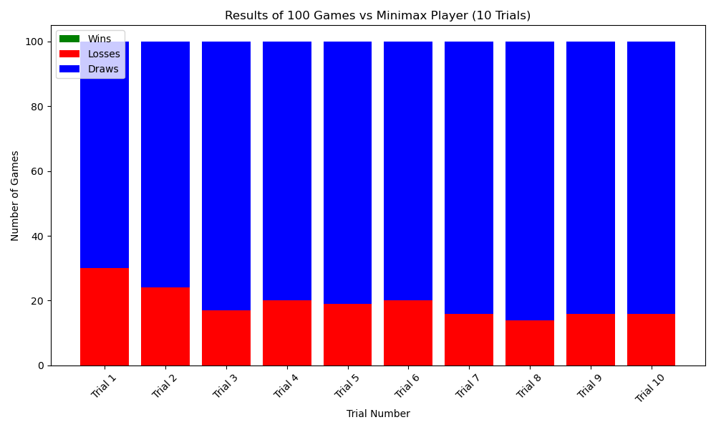
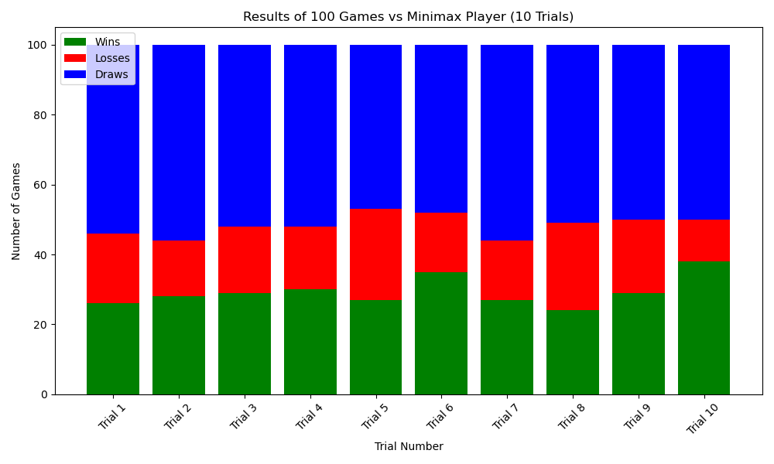
Performance Evaluation
1st Player: Agent Vs. 2nd Player: Minimax
1st Player: Agent Vs. 2nd Player: Agent

Slide 14
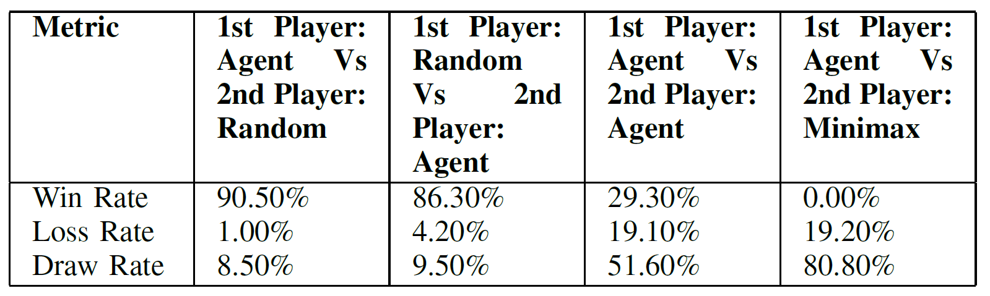
Summary
These results demonstrates the effectiveness of Q-learning in achieving high performance against random opponents but also highlights areas for enhancement.
Central limit theorem and Nash equilibrium dictates that playing optimally* always yields a draw in a game of tic-tac-toe, just like it does in chess.
Theoretically, in perfect-information, deterministic two-player zero-sum game (like chess, checkers, Tic-Tac-Toe), there is always at least one Nash Equilibrium (and mostly coincides with "perfect playing" strategies).

Slide 15
Challenges & Future Work
Challenges Encountered:
Balancing exploration vs exploitation during training
Convergence speed in large state spaces
Difficulty against optimal (Minimax) opponents
Future Work:
Implement Deep Q-Learning for more depth possibility
Expansion to larger grid games (e.g., maybe 4x4 Tic-Tac-Toe, or introducing asymmetry)
Introduce more complex exploration strategies (e.g., epsilon decay, UCB)

Slide 16
Thank You Question & Answer

